Slide 1
High-Level Synthesis (HLS)
-From Algorithmic level to RTL
Song Chen
Dept. of Electronic Science & Technology, USTC
October 8, 2015
http:// staff.ustc.edu.cn/~songch/vlsi-cad.htm
Notes:
Behavioral Description & Register Transfer Level Description ?
What is the difference?

Slide 2
Outline
Electronic System Level Design
  From Algorithm to RTL : Manual -> Automatic
  A Design Example
    Great Common Divisor (Modified from Arvid@MIT)
High-level Synthesis
  DFG/CDFG
  Scheduling
  Binding
  Allocation

Slide 3
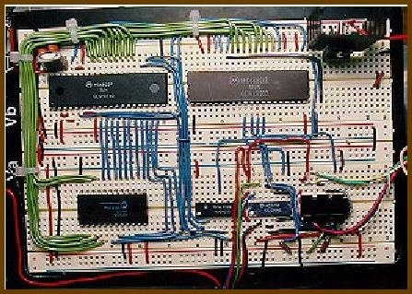
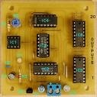
Originally designers used breadboards for prototyping
Number of Gates
in Design
Solderless
Breadboard
10⁷
10⁶
10⁵
tangentsoft.net/elec/breadboard.html
No symbolic execution or testing
10⁴
10³
Printed circuit board
10²
home.cogeco.ca
10

Slide 4
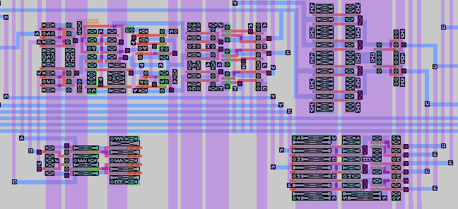
HDL + Tools for Automatic Translation
Simulate
Number of Gates
in Design
Behavioral
Algorithm
Test
Results
10⁷
High-level Synthesis
Simulate
10⁶
Register
Transfer Level
Test
Results
10⁵
Logic Synthesis
Simulate
10⁴
Test
Results
Gate Level
10³
Auto Place + Route
10²
10

Slide 5
Electronic System Level Design
System Function: Algorithmic or transfer functions
  To cope with the challenges of designing emerging billion transistor system-on-chips
    An abstraction level above RTL
High-level synthesis (HLS)
  Enabling technology for ESL design, also known as behavioral synthesis
  Bridges between an algorithmic description of a design and its structural implementation at the RTL
  Next natural step in design automation, succeeding logic synthesis

Slide 6
A Design Example
Greatest Common Divisor
  27, 15
    27%15 = 12
    15%12 = 3
    12%3 = 0
    GCD(27, 15) = 3
int GCD( int inA, int inB)
{ int done = 0;
int A = inA;
int B = inB;
while ( !done )
{ if ( A < B )
{ swap = A;
A = B;
B = swap;
}
else if ( B != 0 )
A = A - B;
else
done = 1;
}
return A;
}

Slide 7
Behavioral GCD in Verilog
module gcdGCDUnit_behav#( parameter W = 16 )
( input [W-1:0] inA, inB,
output [W-1:0] out );
reg [W-1:0] A, B, out, swap;
integer done;
always @(*)
begin
done = 0; A = inA; B = inB;
while ( !done )
begin
if ( A < B )
swap = A;
A = B; B = swap;
else if ( B != 0 )
A = A - B;
else
done = 1;
end
out = A;
end endmodule
User sets the input operands and checks the output; the answer will appear immediately, like a combinational circuit
Note data dependent loop, “done”

Slide 8
Deriving an RTL model for GCD
module gcdGCDUnit_behav#( parameter W = 16 )
( input [W-1:0] inA, inB,
output [W-1:0] out );
reg [W-1:0] A, B, out, swap;
integer done;
always @(*)
begin
done = 0; A = inA; B = inB;
while ( !done )
begin
if ( A < B )
swap = A;
A = B; B = swap;
else if ( B != 0 )
A = A - B;
else
done = 1;
end
out = A;
end endmodule
What does the RTL implementation need?
State (Register)
Less-Than Comparator
Equal Comparator
Subtractor

Slide 9
Step 1: Design an appropriate port interface
input_available
result_rdy
idle
result_taken
operand_A
result_data
operand_B
clk
reset

Slide 10
Step 2: Design a Datapath which has the functional units
zero?
lt
A = inA; B = inB;
while ( !done )
begin
if ( A < B )
swap = A;
A = B;
B = swap;
else if (B != 0)
A = A - B;
else
done = 1;
End
Y = A;
A
sub
B
Notes:
Datapath
An interconnection of resources () whose execution times and input/output data are determined by the control unit according to a schedule.

Slide 11
Step 3: Add the control unit to sequence the datapath
Control unit is designed to be either busy or waiting for input or waiting for output to be picked up
A
sel
A
en
B
sel
B
en
B=0
A<B
zero?
lt
A = inA; B = inB;
while ( !done )
begin
if ( A < B )
swap = A;
A = B;
B = swap;
else if (B != 0)
A = A - B;
else
done = 1;
End
Y = A;
A
sub
B

Slide 12
Datapath module interface
module gcdGCDUnitDpath_sstr#( parameter W = 16 )
( input clk,
// Data signals
input [W-1:0] operand_A,
input [W-1:0] operand_B,
output [W-1:0] result_data,
// Control signals (ctrl->dpath)
input A_en,
input B_en,
input [1:0] A_sel,
input B_sel,
// Control signals (dpath->ctrl)
output B_zero,
output A_lt_B
);
A
sel
A
en
B
sel
B
en
B = 0
A < B
zero?
lt
A
sub
B

Slide 13
Control unit requires a state machine for valid/ready signals
reset
WAIT: begin
A_sel = A_SEL_IN;
A_en = 1'b1;
B_sel = B_SEL_IN;
B_en = 1'b1;
end
CALC: if ( A_lt_B )
A_sel = A_SEL_B;
A_en = 1'b1;
B_sel = B_SEL_A;
B_en = 1'b1;
else if ( !B_zero )
A_sel = A_SEL_SUB;
A_en = 1'b1;
end
DONE: result_rdy = 1'b1;
WAIT
Waiting for new input operands
input_availble
CALC
Swapping and subtracting
( B = 0 )
DONE
Waiting for consumer to take the result
result_taken

Slide 14
FSM state transitions
always @(*)
begin
// Default is to stay in the same state
state_next = state;
case ( state )
WAIT :
if ( input_available )
state_next = CALC;
CALC :
if ( B_zero )
state_next = DONE;
DONE :
if ( result_taken )
state_next = WAIT;
endcase
end
reset
WAIT
input_availble
CALC
( B = 0 )
DONE
result_taken

Slide 15
RTL test harness requires proper handling of the ready/valid signals
Generic
Test Source
Generic
Test
Sink
A
sel
A
en
B
sel
B
en
B = 0
A < B
zero?
lt
A
sub
B
RTL
Model
Test Outputs
Identical?
Test Inputs
Behavioral
Model
Test Outputs

Slide 16
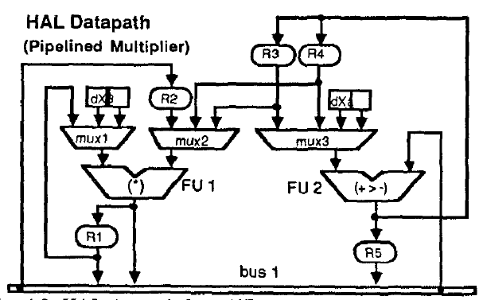
From Behavioral Description to RTL
Datapath
  Resources (arithmetic or logic),
  Steering logic circuits (multiplexers, buses, etc.)
  Registers or Memories
Control Unit: Finite State Machine
while (x < a){
x1 = x + dx;
u1 = u - ( 3 * x * u
* dx) - (3 * y * dx);
y1 = y + ( u * dx);
c = x < a;
x = x1;
u = u1;
end
y = y1;

Slide 17
Architecture Synthesis
Deal with “computational” behavioral descriptions
  Behavior as a sequencing graph: Data flow graph
  Hardware resources as library elements
    Pipelined or non-pipelined
    Resource performance in terms of execution delay
  Constraints on operation timing
  Constraints on hardware resource availability
  Storage as registers, memories,
  data transfer using wires

Slide 18
Architecture Synthesis – Cont’
Objective
  Generate a synchronous, single-phase clock circuit
  Might have multiple feasible solutions (explore tradeoff)
  Satisfy constraints, minimize objective:
    Maximize performance subject to area constraint
    Minimize area subject to performance constraints
    Minimize Power subject to performance constraints

Slide 19
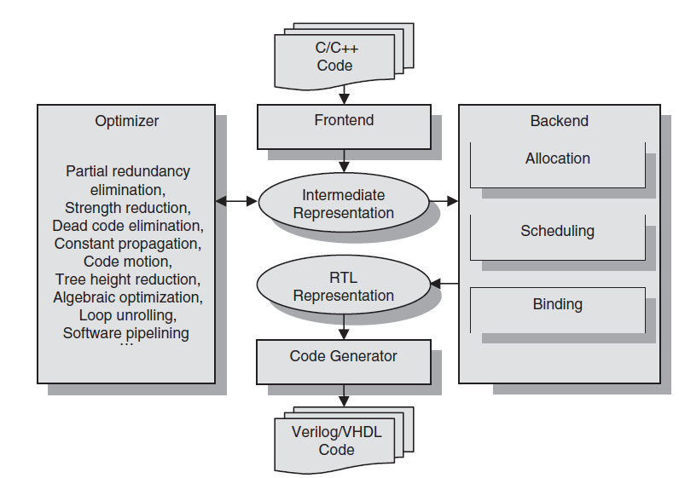
Typical HLS Flow

Slide 20
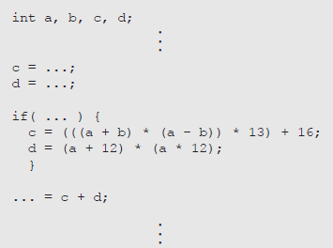
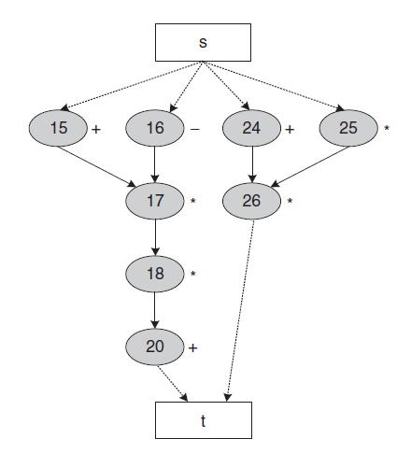
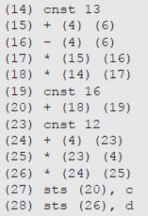
Data Flow Graph

Slide 21
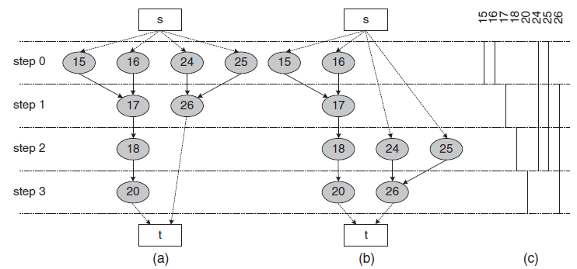
Scheduling
Add/Sub: 15, 16, 20, 24; Mult: 17, 18, 25, 26
  ASAP Scheduling & ALAP Scheduling
    Topological Order
How many adders and multipliers?

Slide 22
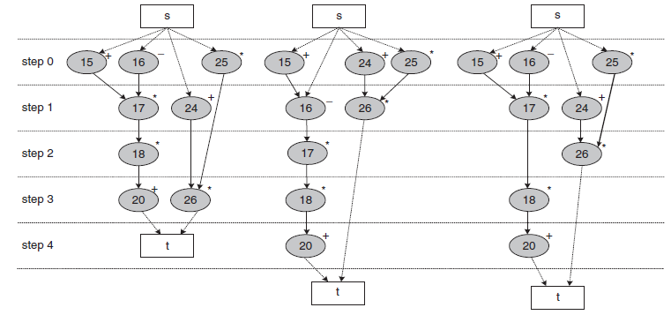
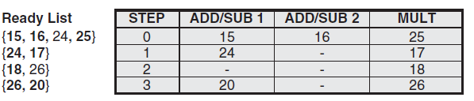
List Scheduling – Resource Constrained
Add/Sub: 15, 16, 20, 24; Mult: 17, 18, 25, 26
  Mobility range as the priority function
Mobility

Slide 23
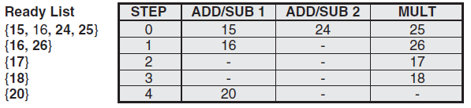
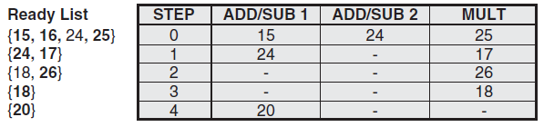
List Scheduling - Example
Add/Sub: 15, 16, 20, 24; Mult: 17, 18, 25, 26
  Random priority function
Mobility
Random

Slide 24
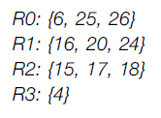
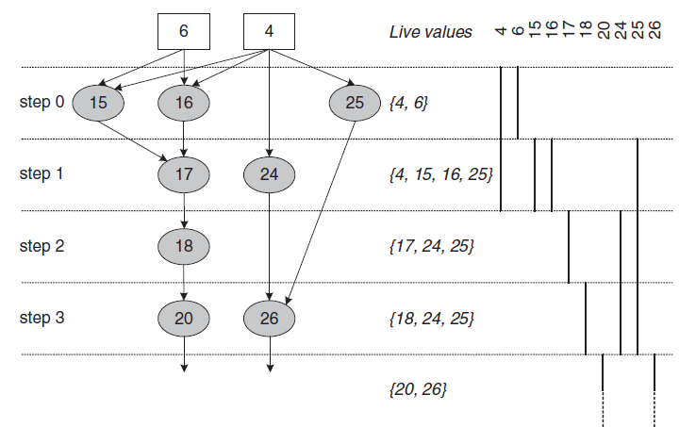
Register Binding
Register sharing
  Liveness analysis & Left edge algorithm

Slide 25
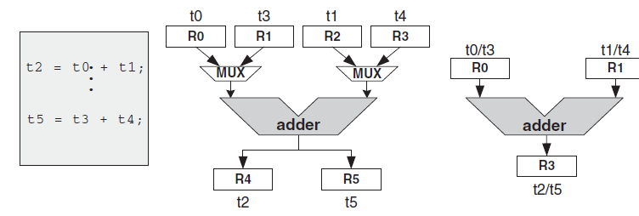
Functional Unit Binding
Impact of register sharing on multiplexers
  In an ASIC, six-input multiplexer -> an adder
  In FPGA, typically implemented as lookup tables, often larger than adders.

Slide 26
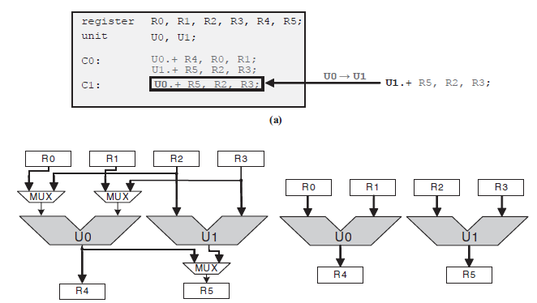
Functional Unit Binding
Impaction of functional unit binding on multiplexers

Slide 27
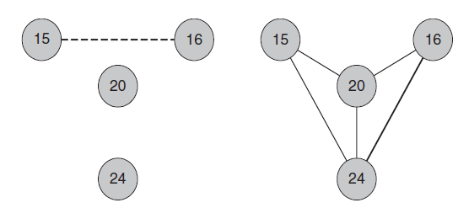
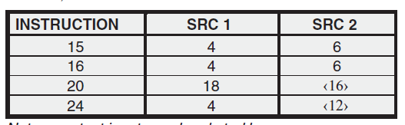
Functional Unit Binding
Add/Sub: 15, 16, 20, 24; Mult: 17, 18, 25, 26
Interference graph & Compatibility graph

Slide 28
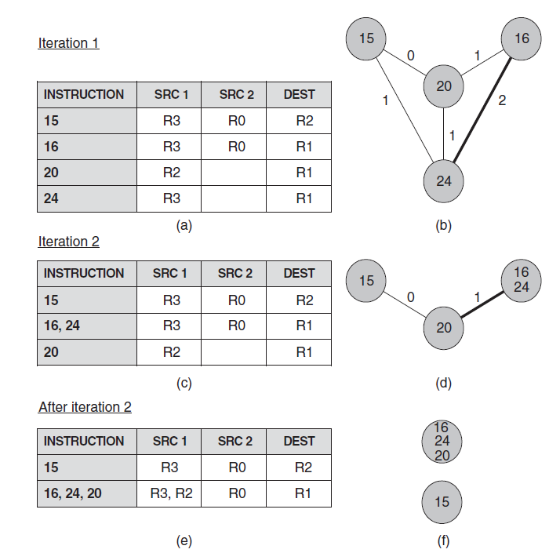
Functional Unit Binding
Iterative Clique Partitioning

Slide 29
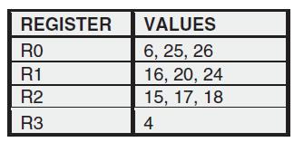
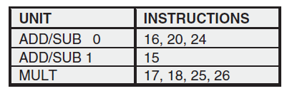
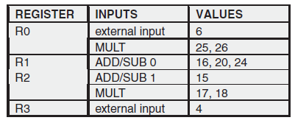
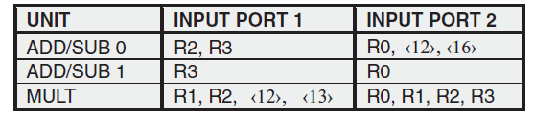
Combine Scheduling, Register/Functional Unit Binding

Slide 30
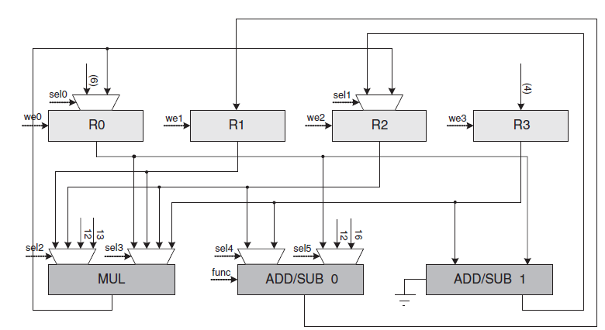

Synthesized datapath

Slide 31
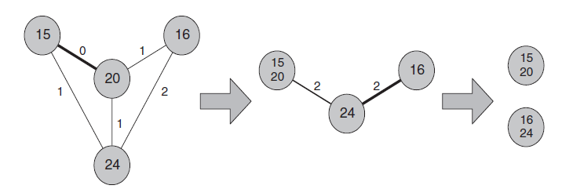
Clique partitioning binding
Randomly select the contracted edge

Slide 32
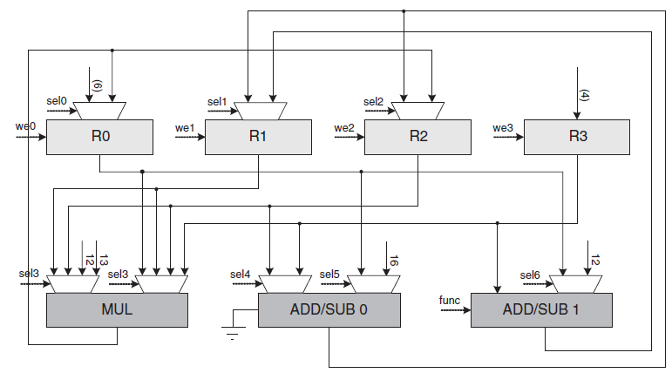
Synthesized datapath

Slide 33
Summary
A Design Example
  Great Common Divisor
High-level Synthesis
  DFG/CDFG
  Scheduling
    ASAP, ALAP, and List Scheduling
  Binding
    Register binding, Functional unit binding (sharing)
  Allocation

